Slide 1


Business Analytics

Slide 2
Presentation
Objectives: Introduce lecturers and students and share the general content of the course paying special attention to any subject of special interest for the attendants
Who we are?
What are we going to do?
How are we going to do?
What is Business Analytics?

Slide 3
Who we are?
Ivan Cabeza Mora
ivan.cabeza@ub.edu
Associated Professor at Economic Studies in University of Barcelona.
Master co-director Entertainment & Sport industry Innovation. IEF- Barcelona Finance School.
Co-founder Laudem Partners s.l. , member of 4 administration boards (Sectors: Construction, Medical services, Bio tech, Fan engagement).
Academic Background:
Graduate in Business Administration - University of Barcelona.
Postgraduate studies in International commerce in ESCI-UPF.
TEFI Esade.

Slide 4
What are we going to do?
What is Business Analytics?
Impact of Business Analytics in a Company. General approach
Business Analytics impact in Marketing
Business Analytics impact in Human Resource Management and Organization Models
How to evaluate new opportunities
Impact of Business Analytics in different sectors: New Business and transformation

Slide 5
What are we going to do?
Presentation.
Objectives: Introduce the lecturers and students and share the general content of the course paying special attention to any subject of special interest for the attendants.
What is Business Analytics?
Objectives: Introduce the concept of Business Analytics ant why is important now. Review the history of data management in business to learn from errors.
What is Business Analytics? What the market says.
Objectives: Once we have reviewed formal definition of Business Analytics we will check what the market says about this subject.
Impact of Business Analytics in a Company. General approach.
Objectives: We will dedicate this sessions to analyze what is the impact of gathering, managing and analyzing data in the different areas of a Company
Value Chain in a company. What is and why we use. Canvas model as an alternative.
New Value Chain: Impact of Business Analytics.

Slide 6
What are we going to do?
Business Analytics impact in Marketing.
Digital Marketing Mix: new products, dynamic pricing, distribution channels anymore, promotion no more.
What we know about clients and what we would like to know… and why. Prescription is the word.
Social Media. How to convert data in value.
IoT. What’s next and what are we going to do with?
Business Analytics impact in Human Resource Management and Organization Models.
New profiles: where are them, how to capture and how to retain.
Data oriented companies: no more doubt, everything has changed.
How to evaluate new opportunities.
What is the value of the data? Will it appear in liabilities?
Changes in financial statements: Data economy. Challenges and opportunities.
Notes:
The four P’s of Marketing: Price, Product, Place, Promotion

Slide 7
What are we going to do?
Impact of Business Analytics in different sectors: New Business and transformation.
Manufacturing, Telecommunications, Retail and Public Services.
Finance and Insurance, Health, Utilities and Energy.
How to adopt. There is no option.
Framework for the adoption of Business Analytics. Is not just “fashion”.

Slide 8
How are we going to do?
We will be together for 15 sessions beginning 15th February till 23/30th of May.
We will share sessions every Thursday from 18:00 till 20:00.
Your will have to work on your own at least 1 additional hour every week… or more.
In general:
You will have to prepare (read and if possible understand) the contents of every session in advance. I will publish it in Campus Virtual 1 week before so you will have a full week to prepare this contents.
Every session (more or less) you will have to complete a test related with the material you have prepared during the week. It will take between 10 and 15 minutes.
Then we will review all together the test and you will check if you have done it correct.
Finally we will review all the contents and we will focus on the most important ones so you will have prepared it, have done the test, review the test all together and have done a final review of the most important parts of contents.
Then I will publish contents for next session and repeat the process.

Slide 9
How are we going to do?
But…
You will have to prepare at least 3 business cases at home… It’s homework.
You will have to present and defend this 3 business cases at virtual sessions. So on this sessions maybe we don’t have time to do the tests.
This homework will be used to evaluate you:
I will evaluate every homework.
I will use the best 2 evaluations with a weight of 20% each one to compose your final grade.
Additionally global participation in session will have a weigh of another 20%.
And a final evaluations with a weigh of a 40%.
This 3 items will compose your final grade.
Anyway you have the option of final evaluation

Slide 10
What is Business Analytics?
Something maybe we don’t need to develop business.

Slide 11
What is Business Analytics?
Something maybe we don’t need to develop business.

Slide 12
What is Business Analytics?
Something maybe we don’t need to develop business.

Slide 13
What is Business Analytics?
Something maybe we don’t need to develop business.

Slide 14
What is Business Analytics?
But it not allways works…

Slide 15


Slide 16
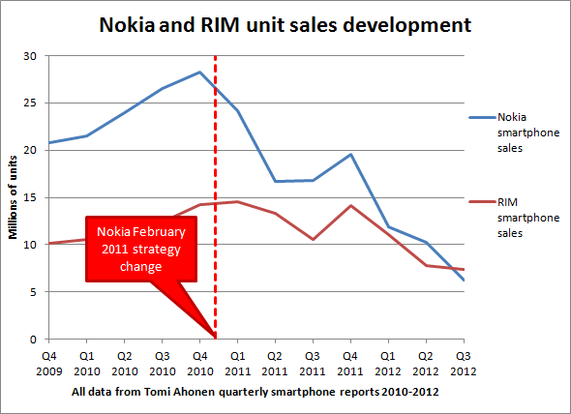

Slide 17
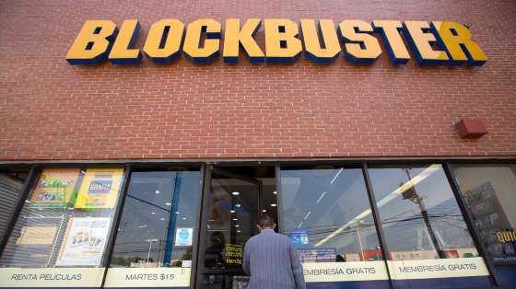

Slide 18
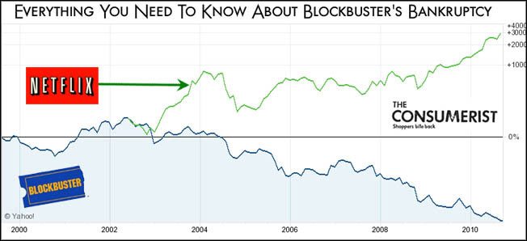

Slide 19
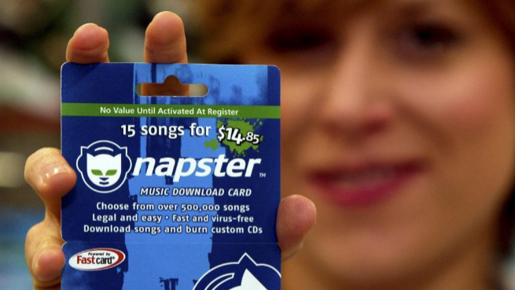

Slide 20
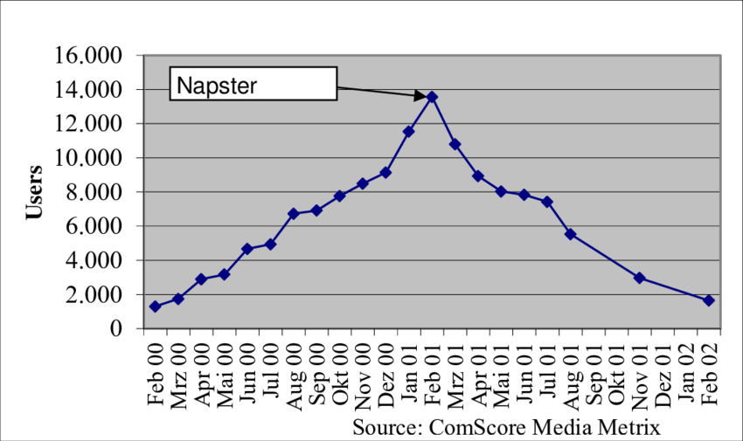

Slide 21


Slide 22




Slide 23
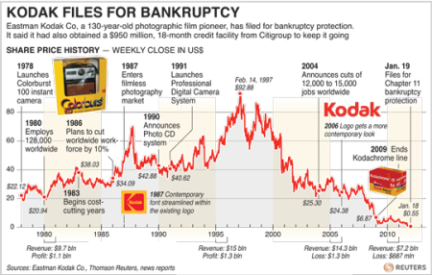

Slide 24
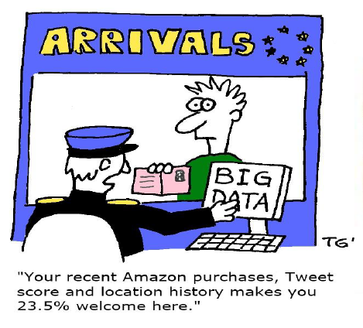

Slide 25
Thank You

